Slide 1
EARLY DETECTION OF CHRONIC KIDNEY DISEASE USING MACHINE LEARNING
SHIBANI SENTHIL KUMAR - 2019115095
SHIVANI KUJULUVA KARTHIKEYAN - 2019115096
SNEHA TIROUMOUROUGANE - 2019115099
TREASA GEORGE – 2019115115

Slide 2
DOMAIN : APPLIED DATA SCIENCE
PROBLEM STATEMENT : Chronic Kidney Disease (CKD) is a major medical problem and can be cured if treated in the early stages. Usually, people are not aware that medical tests we take for different purposes could contain valuable information concerning kidney diseases.
Consequently, attributes of various medical tests are investigated to distinguish which attributes may contain helpful information about the disease.
The information says that it helps us to measure the severity of the problem and we make use of such information to build a machine learning model that predicts Chronic Kidney Disease.

Slide 3
INTRODUCTION
Chronic Kidney Disease (CKD) is a major medical problem and can be cured if treated in the early stages. The goal is to use machine learning algorithms to assess the underlying prediction of severe renal infections, also known as extreme kidney diseases.
The main causes of chronic kidney disease include excessive blood pressure and diabetes. A person with chronic kidney disease (CKD) is more likely to pass away at a young age.
The main goal of this project is to detect several illnesses linked to CKD in order to avert the disease. This project offers a novel machine learning approach for early CKD detection and prediction.

Slide 4
LITERATURE REVIEW
Researcher and Research paper | Year | Classifier | Accuracy | Remarks
Naganna Chetty “Role of Attributes Selection in Classification of Chronic Kidney Disease Patients ” | 2015 | Naïve Bayes, SMO, IBK | 99%, 98.25%, 100% | Attribute reduction using Wrapper Method
S. Vijayarani “Kidney disease prediction using svm and ann algorithms” | 2015 | SVM | 76.32% | 584 Instances and 6 attributes
L. Jerlin Rubini “Generating comparative analysis of early stage prediction of Chronic Kidney Disease” | 2015 | Multilayer Preceptor | 99.75% | Performed better than radial basis function network, Logistic Regression
Uma N Dulhare “Extraction of Action Rules for Chronic Kidney Disease using Naïve Bayes Classifier” | 2016 | Naïve Bayes | 97.5% | Attribute reduction using OneR
Wala A “Missing data classification of chronic kidney disease” | 2017 | Decision Tree | 99% | Missing values are replaced with mean

Slide 5
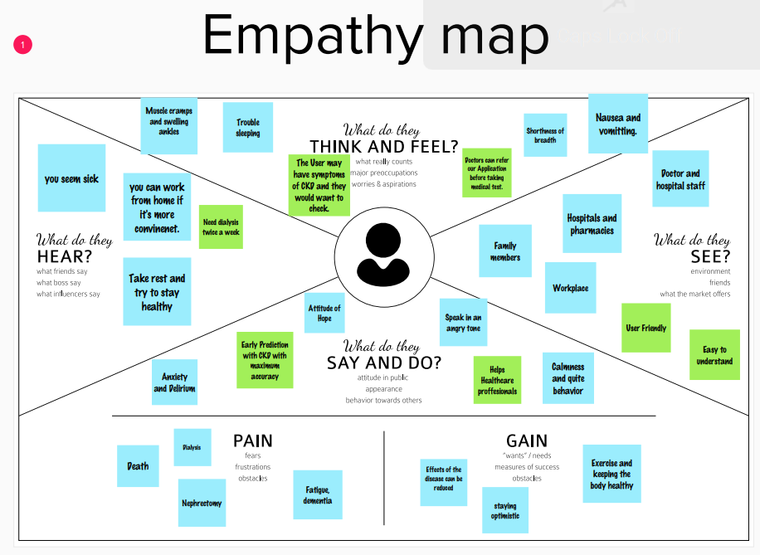

Slide 6
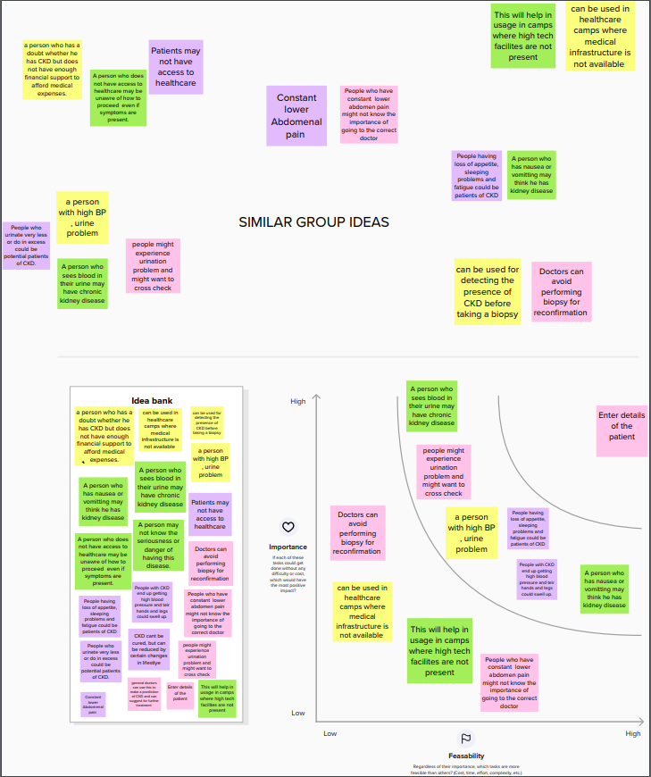
BRAINSTORMING IDEAS

Slide 7
SOCIAL IMPACT
It will be useful for anyone who has diseases related to their kidney as well as anyone in the medical profession.

Slide 8
NOVELTY
Ability to detect CKD using Machine learning algorithms while considering the least number of features.

Slide 9
SCALABILITY OF THE SOLUTION
It can be used by doctor and patient for a second opinion for their Kidney related problems.

Slide 10
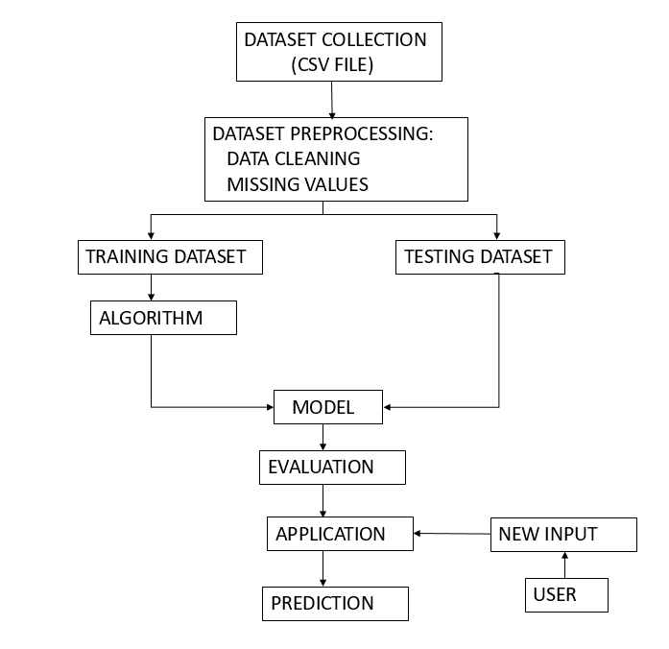
ARCHITECTURE

Slide 11
THANK YOU

